Slide 1
The Anonymous Messaging System
Manasik Hassan, Nadia Charef
Nafisah Abdulkadir, Nikita Punnoose

Slide 2
Table of contents
Introduction
System Architecture
Challenges
Visualization and Demo

Slide 3
Introduction
Distributed systems and applications are preferred due to many advantages it brings. However, due to the unique approach of the system architecture & how information are maintained within it, security within distributed systems is of considerable importance.

Slide 4
Project Objectives
To implement a special kind of distributed publisher-subscriber system enabling two or more clients to communicate anonymously.
Ensuring the anonymity of data communications by using randomly generated ID for sending and retrieving messages.

Slide 5
2. System Architecture

Slide 6





Technologies We Used
Backend
Frontend
Scalable, Flexible, and lightweight
HTML and Javascript (JQuery)
Hosting Platform
Many Standard Libraries, one of the top programing languages for web development
A scalable cloud platform to host
the web app.

Slide 7
System Functionalities
Three main processes:
Client sends a message to Facilitator
Facilitator runs similarity checks based on the randomly generated ID and updates the DB
Client retrieves a message from Facilitator

Slide 8
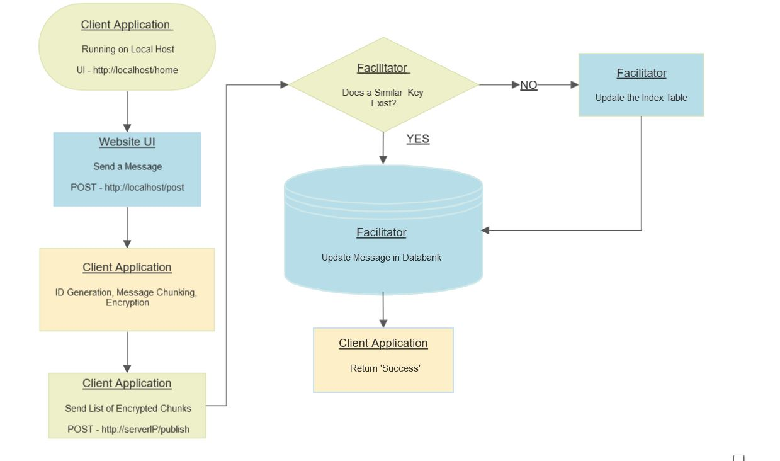
Sending a Message

Slide 9
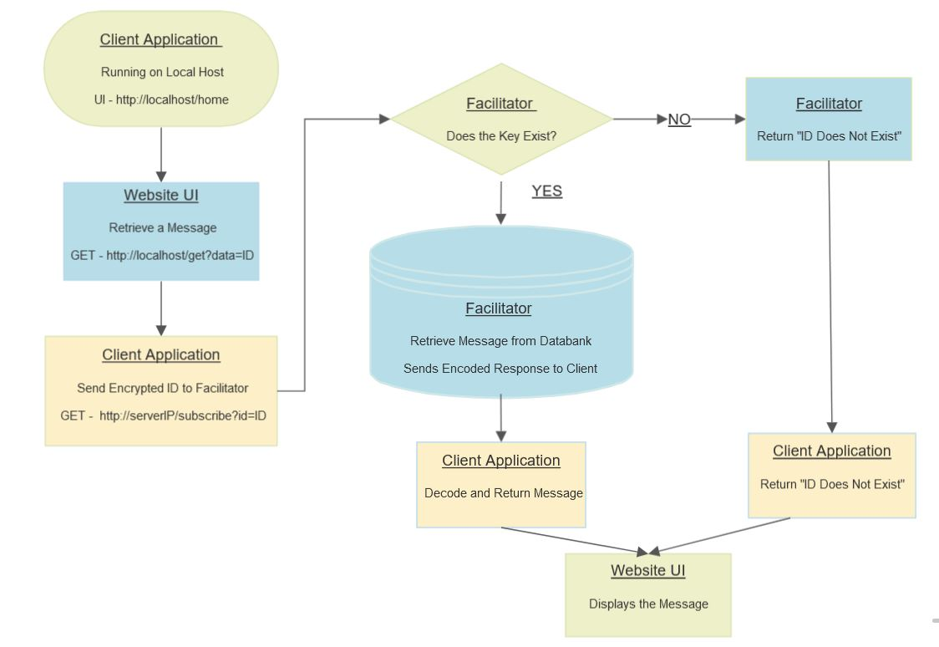
Retrieving a Message

Slide 10
3. Challenges
System Scalability
Key
Exchange
Processing
Time
Implement an auto scaling group on the AWS server
Implement the mechanism for sharing keys between subscriber and publisher
Time taken to encrypt/decrypt message for large data can affect the response time

Slide 11
4. Visualization
and Demo

Slide 12
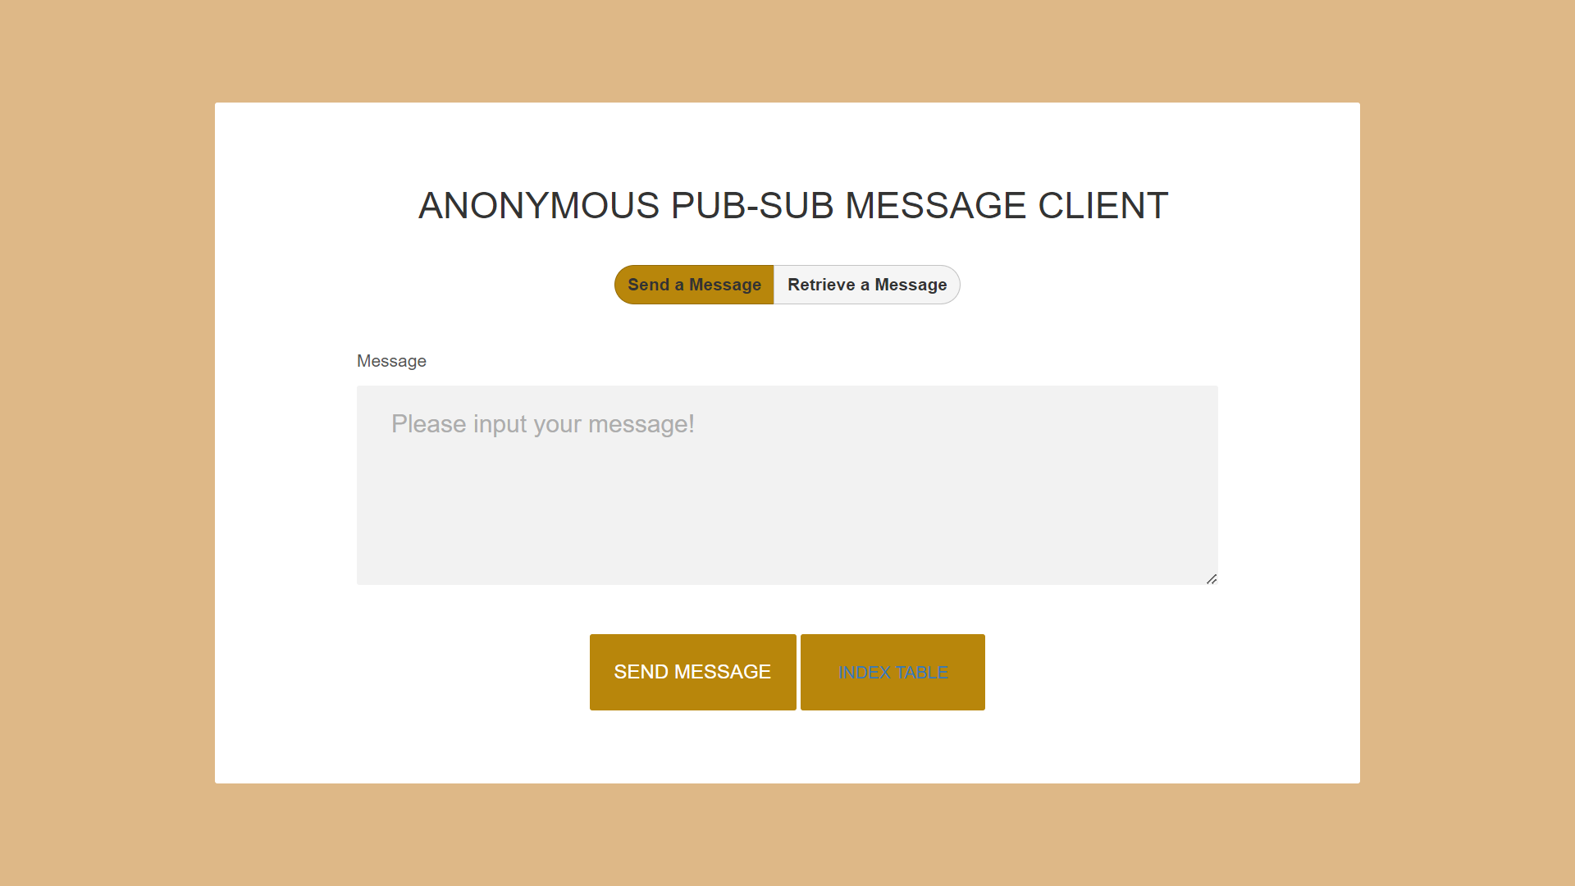
To send a message:

Slide 13
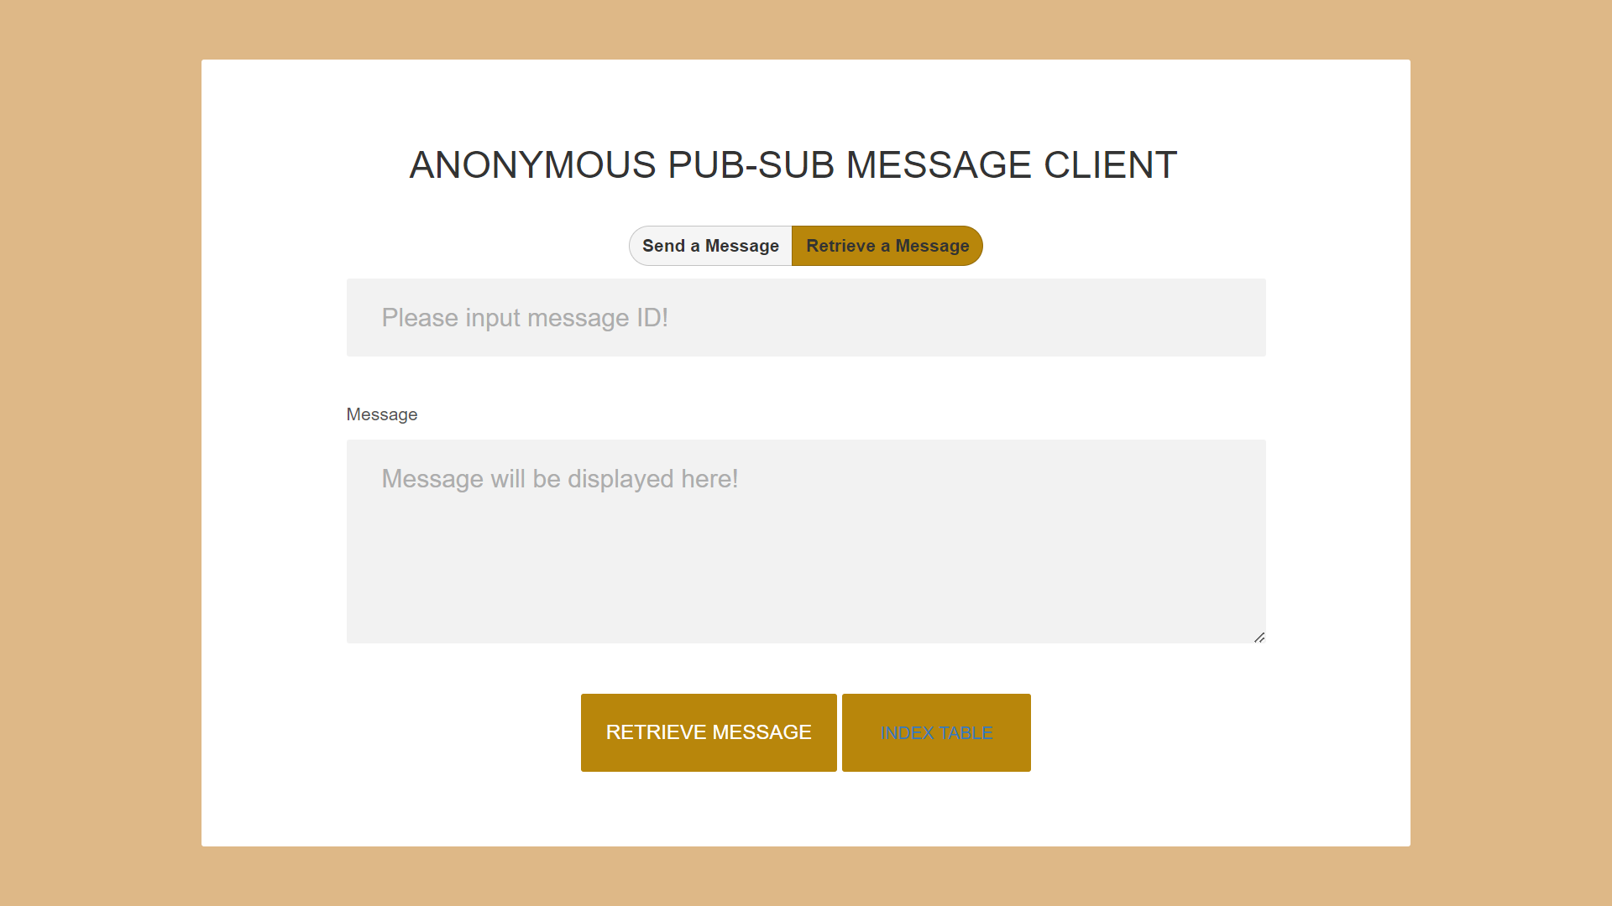
To retrieve a message:

Slide 14

ID table:

Slide 15
Thanks!
Do you have any questions?

